Slide 1
Predicting The Number of Tweet Counts For An Article
Project Members:
Srikar Akula Abhi Sekhar Reddy Dwarampudi Hari Durga prasad karri RAHUL marupaka

Slide 2
Introduction
Predicting the number of tweet counts for a certain article using the altmetrics data.
There are approximately 250k rows of data that has been extracted from Altmetrics JSON files.
We converted JSON data into Comma Separated Value document.

Slide 3
Steps followed
Data Exploration – This is the first step in data analysis and it typically involves summarizing the main characteristics of a dataset. It is commonly conducted using visual analytics tools, but can also be done in more advanced statistical software.
Data Cleaning - It is the process of cleaning / standardizing the data to make it ready for analysis. Most of times, there will be inconsistencies in the captured data such as incorrect data formats, missing data, errors while capturing the data. This is an important step in any given data science project because the accuracy of the results depends heavily on the data we use.

Slide 4
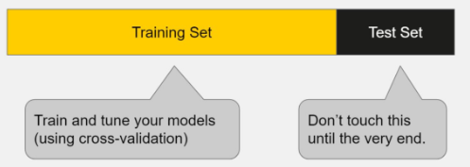
Data Training & Testing
Training and Testing the model:
If you evaluate your model on the same data you used to train it, your model could be very overfit and you wouldn’t even know! A model should be judged on its ability to predict new, unseen data. Therefore, you should have separate training and test subsets of your dataset.
Notes:
Training sets are used to fit and tune your models. Test sets are put aside as "unseen" data to evaluate your models.
You should always split your data before doing anything else.
This is the best way to get reliable estimates of your models’ performance.
After splitting your data, don’t touch your test set until you’re ready to choose your final model!
For our project, From the data we have we used 80% of it as a Training data and the rest 20% as Test data

Slide 5
Data Cleaning
All the data from the Altmetric Dataset has been extracted first in order to find out the features that are useful for the Considered project
After extracting the data, which resulted in a huge number of JSON files we have considered 3,00,000 samples
We have found that there are many features available upon checking the data samples through JSON reader. As the numerical data would train the model better for our project in predicting the count of users who will tweet the article.

Slide 6
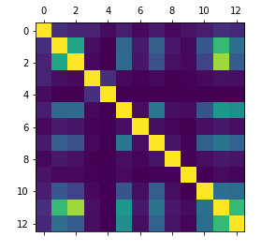
Heatmap
We have considered heat map in order to check and detect the high correlation features for accuracy.
We have started with 12 features:
mendeley_count
blogs_count
news_count
citeulike_count
connotea_count
facebook_count
wikipedia_count
googleplus_count
qna_count
policy_count
reddit_count
altmetric_score

Slide 7
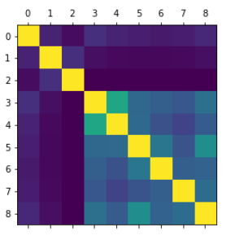
Heatmap for 8 features
mendeley_count
blogs_count
wikipedia_count
facebook_count
citeulike_count
connotea_count
googleplus_count
reddit_count

Slide 8
Feature Filtering
Since there are many 0’s in certain features, inorder to improve the efficiency of model it is important to consider highly correlated features. Which can be done using heatmap
Highly correlated features are represented with light colors in the Heatmap
Upon multiple trails on all the 12 different features, We achieved the better accuracy when the below three features are considered.
1. mendeley_count 5. facebook_count
2. citeulike_count 6. connotea_count
3. googleplus_count 7. reddit_count
4. blogs_count 8. news_count

Slide 9
Regression Analysis
Regression is a statistical measure used in finance, investing and other disciplines that attempts to determine the strength of the relationship between one dependent variable (usually denoted by Y) and a series of other changing variables

Slide 10

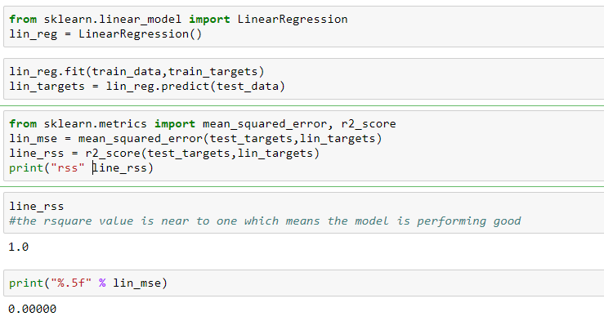
Linear regression
A linear approach for modelling the relationship between a scalar dependent and one or more independent variables.
In our project we used multivariate linear regression.

Slide 11
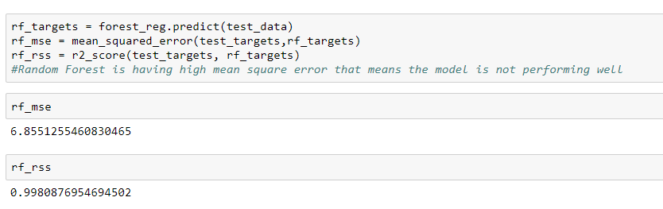
Random Forest Regression
Random Forest, is an ensemble learning for regression that operate by constructing a multitude of decision trees at training time and outputting the mean prediction.

Slide 12
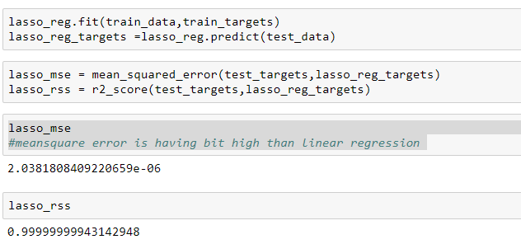
Lasso Regression
Lasso (least absolute shrinkage and selection operator) is a regression analysis method that performs both variable selection and regularization in order to enhance the prediction accuracy and interpretability of the statistical model it produces.

Slide 13
Classification
The goal of classification is to accurately predict the target class for each case in the data.
Each record contains a set of attributes (features), one of the attributes is the class label(target).Here Twitter counts is our target class.
Usually, the data set is divided into training and test sets,
training set used to -> build the model and
test set used to -> validate it (determine its accuracy).

Slide 14
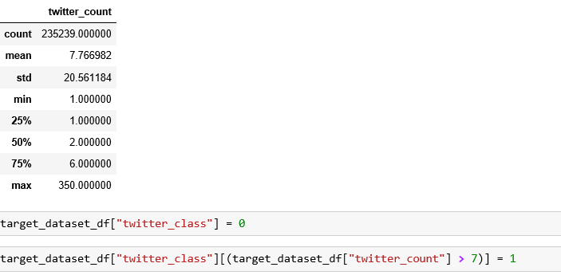
Classification:
Before implementing the classification methods , we have classified the targets class into low and high labels by using the Mean(Average) of Twitter counts present in the dataset.

Slide 15
Removing Outliers
train_test_split() will Split arrays or matrices into random train and test subsets.
We have used 20% as test data,80% for training data and used random state as 42. and remove the outliers of tweet counts >350 and applying classification models.
The classification methods that we have used are:
1) Decision Tree Classifier
2) Random Forest tree
3) Naïve Bayes Classifier

Slide 16
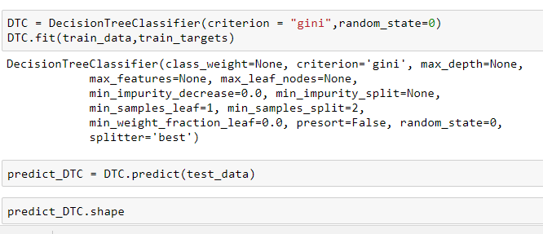
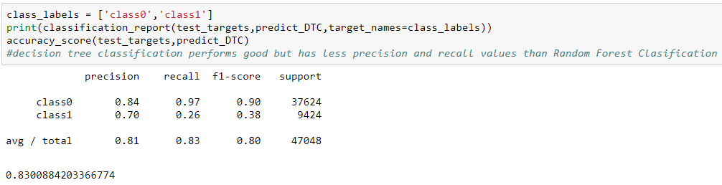
Decision Tree Classifier
Notes:
Accuracy refers to closeness of measured value to a standard value

Slide 17

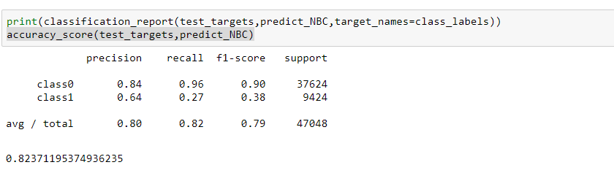
Naïve Bayes Classification :

Slide 18

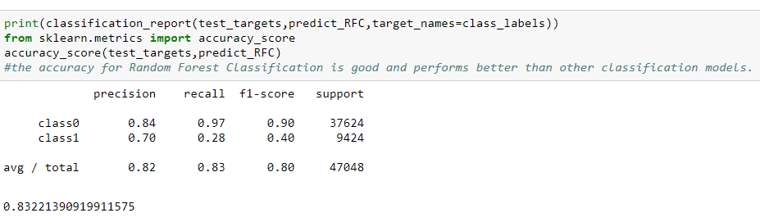
Random Forest Classification

Slide 19
Conclusion:
By Implementing the three classification methods, the Decision Tree Classifier is providing the highest accuracy with 83.2% and it has highest precision and recall values when comparing to other classifier methods.
Using classification methods, we have predicted where the given article will have highest tweet counts or low tweet counts by considering the required features.

